Slide 1
第四章 编程作业
—贪心策略
日期：2023年12月

Slide 2
内容
编程实现下述3个算法， 并利用给定的数据，验证算法正确性，三选一
哈夫曼编码
单源最短路径
最小生成树

Slide 3
作业1 哈夫曼编码
针对 “附件2.哈夫曼编码输入文本-23”给出的文本信息，构造哈夫曼编码
方案1：将文本中的数字0-9、空格、标点符号、换行等控制符用“#”替换，英文字母不区分大小写
统计26个英文字母及#出现的频率
对{a, b, c,..,x, y, z, #}，设计哈夫曼编码
按照哈夫曼编码，对输入文本重新编码
统计采用哈夫曼编码，输入文本需要的存储比特数，并与定长编码方式需要的存储比特数进行比较

Slide 4
作业1 哈夫曼编码
方案2：文本中的数字0-9、空格、标点符号、控制符参与编码，英文字母区分大小写
统计26个英文字母、数字0-9、空格、标点符号、控制符的出现的频率
对{a, b, c,..,x, y, z, 0,…,9, 空格,标点符号}，设计哈夫曼编码
按照哈夫曼编码，对输入文本重新编码
统计采用哈夫曼编码，输入文本需要的存储比特数，并与定长编码方式需要的存储比特数进行比较

Slide 5
作业1 哈夫曼编码
要求：
编程实现方案2
程序运行结果需给出
1. 符号表{a, b, c,..,x, y, z, 0,…,9, …}中各编码成员（字符）在文本中的出现频率，以及其哈夫曼编码
2. 分别采用哈夫曼编码、定长编码时，输入文本所需要的存储比特数

Slide 6
附件1. 哈夫曼编码输入文本内容
Informally, an algorithm is any well defined computational procedure that takes some value, or set of values, as input and produces some value, or set of values, as output. An algorithm is thus a sequence of computational steps that transform the input into the output.
We can also view an algorithm as a tool for solving a well-specified computational problem. The statement of the problem specifies in general terms the desired input/output relationship. The algorithm describes a specific computational procedure for achieving that input/output relationship.
An algorithm is said to be correct if, for every input instance, it halts with the correct output. We say that a correct algorithm solves the given computational problem. An incorrect algorithm might not halt at all on some input instances, or it might halt with an answer other than the desired one. Contrary to what one might expect, incorrect algorithms can sometimes be useful, if their error rate can be controlled. We shall see an example of this in Chapter when we study algorithms for finding large prime numbers. Ordinarily, however, we shall be concerned only with correct algorithms.

Slide 7
附件1. 哈夫曼编码输入文本内容
Algorithms for optimization problems typically go through a sequence of steps, with a set of choices at each step. For many optimization problems, using dynamic programming to determine the best choices is overkill; simpler, more efficient algorithms will do. A greedy algorithm always makes the choice that looks best at the moment. That is, it makes a locally optimal choice in the hope that this choice will lead to a globally optimal solution. This chapter explores optimization problems that are solvable by greedy algorithms.

Slide 8
附件1. 哈夫曼编码输入文本内容
Greedy algorithms do not always yield optimal solutions, but for many problems they do. We shall first examine in Section 16.1 a simple but nontrivial problem, the activity-selection problem, for which a greedy algorithm efficiently computes a solution. We shall arrive at the greedy algorithm by first considering a dynamic-programming solution and then showing that we can always make greedy choices to arrive at an optimal solution. Section 16.2 reviews the basic elements of the greedy approach, giving a more direct approach to proving greedy algorithms correct than the dynamic-programming-based process of Section 16.1. Section 16.3 presents an important application of greedy techniques: the design of data-compression (Huffman) codes. In Section 16.4, we investigate some of the theory underlying combinatorial structures called "matroids" for which a greedy algorithm always produces an optimal solution. Finally, Section 16.5 illustrates the application of matroids using a problem of scheduling unit-time tasks with deadlines and penalties.

Slide 9
附件1. 哈夫曼编码输入文本内容
The greedy method is quite powerful and works well for a wide range of problems. Later chapters will present many algorithms that can be viewed as applications of the greedy method, including minimum-spanning-tree algorithms , Dijkstra's algorithm for shortest paths from a single source, and Chv´atal's greedy set-covering heuristic. Minimum-spanning-tree algorithms are a classic example of the greedy method.
A greedy algorithm obtains an optimal solution to a problem by making a sequence of choices. For each decision point in the algorithm, the choice that seems best at the moment is chosen. This heuristic strategy does not always produce an optimal solution, but as we saw in the activity-selection problem, sometimes it does. This section discusses some of the general properties of greedy methods. The process that we followed in Section 16.1 to develop a greedy algorithm was a bit more involved than is typical.
We went through the following steps:
(1) Determine the optimal substructure of the problem. (2)Develop a recursive solution. (3) Prove that at any stage of the recursion, one of the optimal choices is the greedy choice. Thus, it is always safe to make the greedy choice. (4) Show that all but one of the subproblems induced by having made the greedy choice are empty. (5)Develop a recursive algorithm that implements the greedy strategy. (6)Convert the recursive algorithm to an iterative algorithm.
Ingoing through these steps, we saw in great detail the dynamic-programming underpinnings of a greedy algorithm. In practice, however, we usually streamline the above steps when designing agreedy algorithm. We develop our substructure with an eye toward making a greedy choice that leaves just one subproblem to solve optimally.

Slide 10
附件1. 哈夫曼编码输入文本内容
Greedy-choice property:
The first key ingredient is thegreedy-choice property: aglobally optimal solution can be arrived at by making a locally optimal (greedy) choice. In other words, when we are considering which choice to make, we make the
choice that looks best in the current problem, without considering results from subproblems.
Here is where greedy algorithms differ from dynamic programming. In dynamic programming, we make a choice at each step, but the choice usually depends on the solutions to subproblems. Consequently, we typically solve dynamic-programming problems in a bottom-up manner, progressing from smaller subproblems to larger subproblems. In a greedy algorithm, we make whatever choice seems best at the moment and then solve the subproblem arising after the choice is made. The choice made by a greedy algorithm may depend on choices so far, but it cannot depend on any future choices or on the solutions to subproblems. Thus, unlike dynamic programming, which solves the subproblems bottomup, a greedy strategy usually progresses in a top-down fashion, making one greedy choice after another, reducing each given problem instance to a smaller one.Of course, we must prove that a greedy choice at each step yields a globally optimal solution, and this is where cleverness may be required.

Slide 11
附件1. 哈夫曼编码输入文本内容
Optimal substructure:
A problem exhibits optimal substructure if an optimal solution to the problem contains within it optimal solutions to subproblems. This property is a key ingredient of assessing the applicability of dynamic programming as well as greedy algorithms.
We usually use a more direct approach regarding optimalsubstructure when applying itto greedy algorithms. As mentioned above, wehave the luxury of assuming that we arrived at a subproblem by having made the greedy choice in theoriginal problem. All we really need to do is argue that an optimal solution to the subproblem, combined with the greedy choice already made, yields an optimal solution to the original problem. This scheme implicitly uses induction on the subproblems to prove that making the greedy choice at every step produces an optimal solution.

Slide 12
附件1. 哈夫曼编码输入文本内容
Greedy versus dynamic programming:
Because the optimal-substructure property is exploited by both the greedy and dynamic-programming strategies, one might be tempted to generate a dynamic-programming solution to a problem when a greedy solution suffices, or one might mistakenly think that a greedy solution works when in fact a dynamic-programming solution is required. To illustrate the subtleties between the two techniques, let us investigate two variants of a classical optimization problem.

Slide 13
作业2 单源最短路径
利用“附件1-1.基站图的邻接矩阵-v1-23”给出的LTE网络基站数据，以基站为顶点，以基站间的距离连线为边，组成图，计算图中的单源最短路径
图构造
从昆明LTE网络中，选取部分基站，计算基站间的距离，在部分基站间引入边，得到
22个基站顶点组成的图
42个基站顶点组成的图

Slide 14
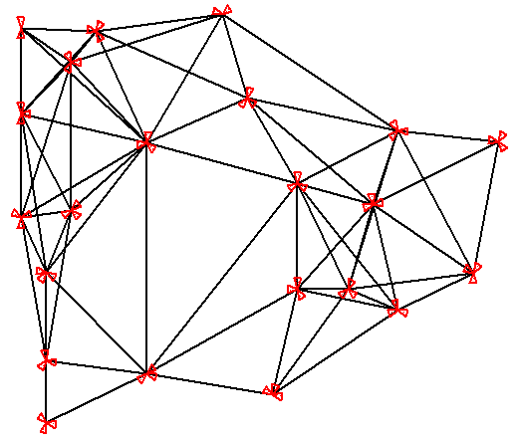
源点基站ID： 567443
5
22
20
17
11
9
7
18
6
19
3
8
16
13
10
4
21
1
2
12
终点基站ID： 33109
14
15

Slide 15
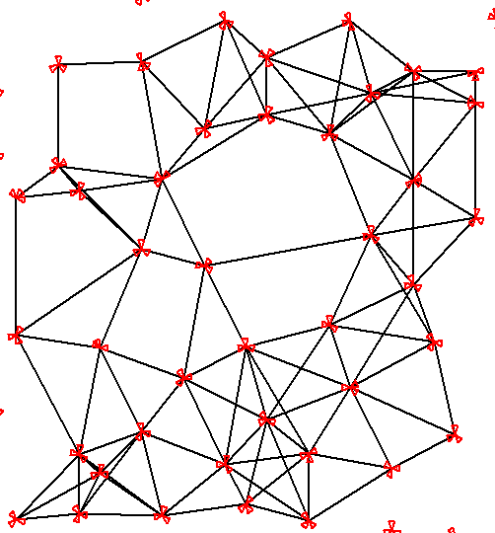
35
37
6
25
16
32
26
源点基站ID： 565845
34
41
31
5
14
29
42
2
40
4
28
21
1
33
19
8
终点基站ID： 565667
22
27
30
23
17
18
12
9
7
3
13
36
15
39
20
38
24
11
10

Slide 16
单源最短路径
对22个基站顶点组成的图，以基站567443为源点
【说明：可以选择其它顶点作为源点】
1. 计算567443到其它各点的单源最短路径
2.计算567443到33109的最短路径
对42个基站顶点组成的图，以基站565845为源点
【说明：可以选择其它顶点作为源点】
1. 计算565845到其它各点的单源最短路径
2. 计算565845到565667的最短路径

Slide 17
作业3 最小生成树
利用“附件1-1.基站图的邻接矩阵-v1-23”给出的LTE网络基站数据，以基站为顶点，以基站间的距离连线为边，组成图，计算图的最小生成树
图构造
从昆明LTE网络中，选取部分基站，计算基站间的距离，在部分基站间引入边，得到
22个基站顶点组成的图
42个基站顶点组成的图

Slide 18
5
22
20
17
11
9
7
18
6
19
3
8
16
13
10
4
21
1
2
12
14
15

Slide 19
35
37
6
25
16
32
26
41
34
31
5
14
29
42
2
40
4
28
21
1
33
19
8
22
27
30
23
17
18
12
9
7
3
13
36
15
39
20
38
24
11
10

Slide 20
最小生成树
编程实现最小生成树算法，采用算法生成这2个图的最小生成树
要求
1. 采用K算法，或P算法，二选一
2. 给出最小生成树的成本/代价/耗费cost
3. 做图，展现最小生成树
注： 可以在原图上，用红色、粗线条，标记最小生成树

Slide 21
评分标准
评分参考标准如下
针对上述典型问题，编程实现算法，程序能够针对一种输入正常运行，给出正确结果，并提交代码及实验报告
算法程序能够面对多种输入和边界条件稳定运行，输出正确结果，算法性能符合预期，并且按期提交代码及实验报告
在满足2的前提下，能够观察对比不同规模的输入数据下，算法的运行时间和空间占用的变化，分析算法时间和空间复杂性
在满足2、3的前提下，提出改进算法性能的思路及方法，并付诸实现

Slide 22
作业提交要求
通过电子邮件，将电子版作业文档（pdf格式）提交课程助教
邮件主题：算法设计与分析作业提交(第xx章)-班级-姓名
文档名称：
班号_学号_姓名_算法设计与分析_第xx章
作业文档内容包括
源程序代码，运行结果
注意事项
各章作业布置后，三周内提交
不要拖到期末各章作业一起提交
研究生助教邮件地址
301-304班，张照鑫，zhangzx@bupt.edu.cn
305-307班，崔文博，jairui@bupt.edu.cn

Slide 23

Thanks for your attention
把数字世界带入每个人、每个家庭、 每个组织，构建万物互联的智能世界。
Bring digital to every person, home and organization for a fully connected, intelligent world.

